Slide 1



Smart Bus Fee Verification System
TEAM MEMBERS : DHANUSHREE B M(25ITR021)
ESAIMOZHI M(25ITR033)
HARINI P(25ITR041)
HARINI SREE L(25ITR042)
INBARASI E(25ITR048)
COURSE | : | 24ITL34 – DESIGN THINKING LABORATORY
EXERCISE | : | 3 – CONDUCT FIELD OBSERVATION FOR YOUR DESIGN CHALLENGE 4 – CONDUCT AN INTERVIEW WITH YOUR CUSTOMER BY USING EMPATHY MAP & JOURNEY MAP
DATE | : | 16.10.2025

Slide 2
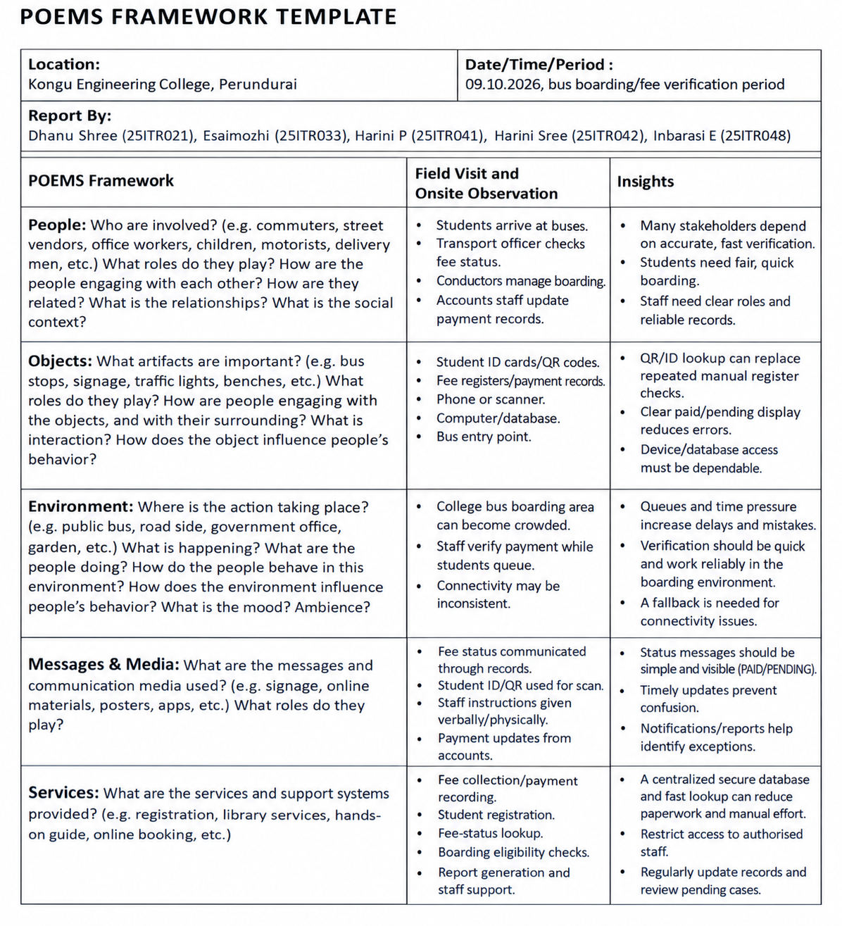

Slide 3

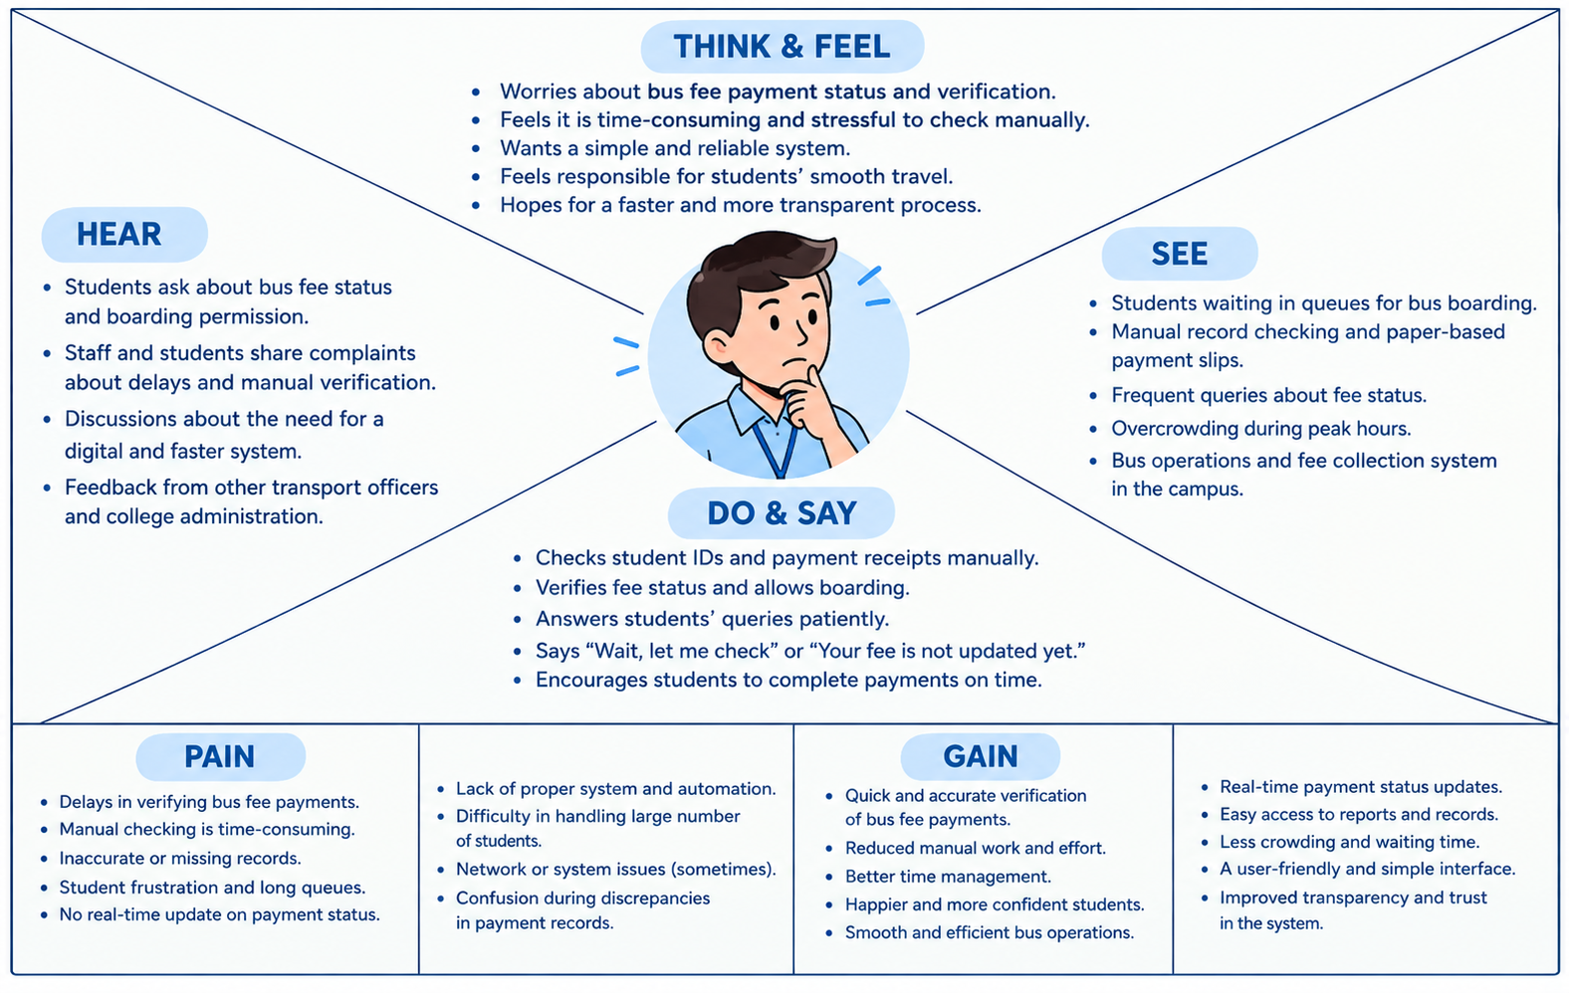
Phase II: Empathize
T17 : Empathy Map – To Generate Interview Question

Slide 4
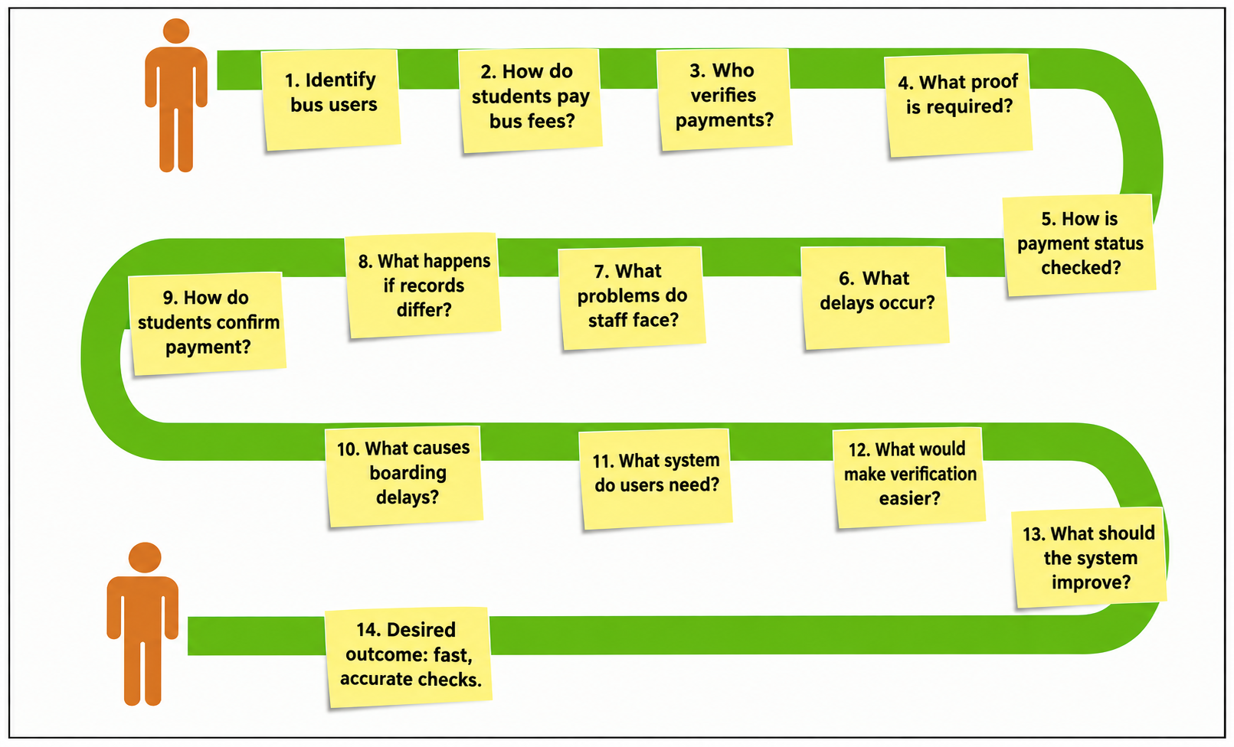
Phase II: Empathize
T18 : Journey Map – To Generate Interview Questions

Slide 5
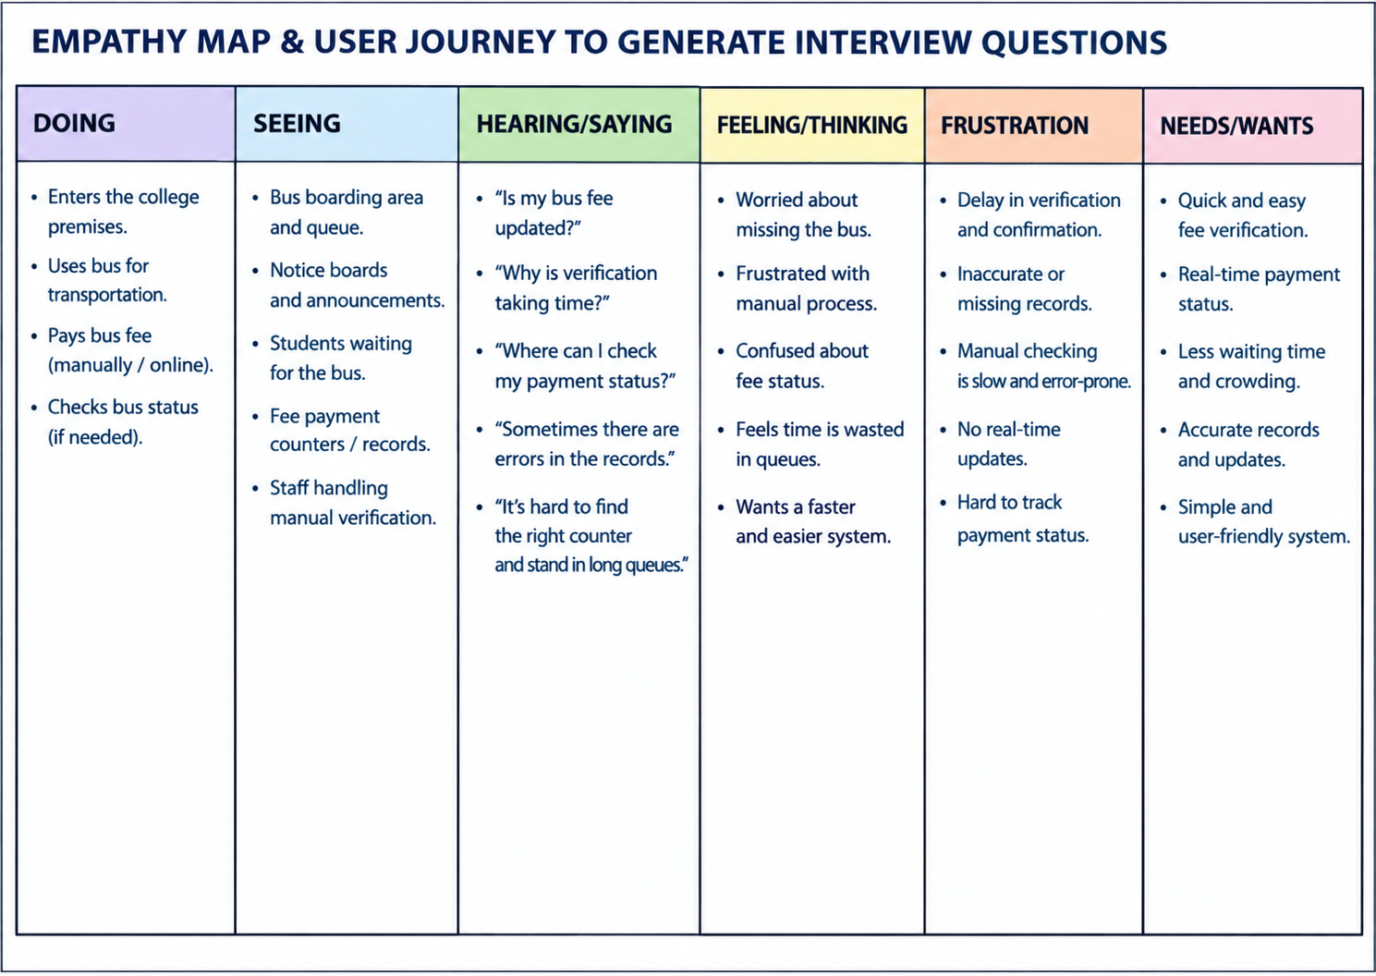
Phase II: Empathize
T19 : Combined Empathy Map & Journey Map – To Generate Interview Questions

Slide 6
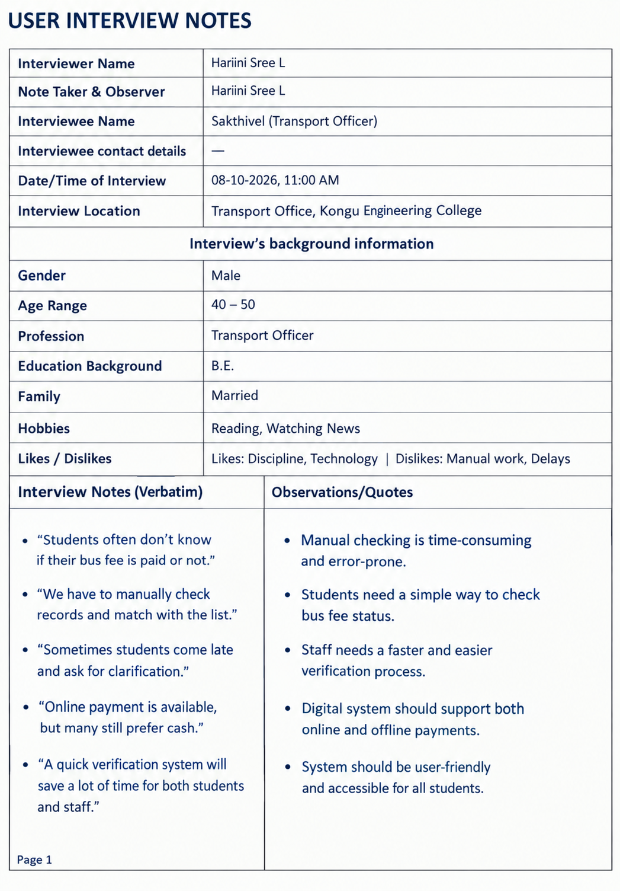
T20 : User Interview Notes
Harini Sree L
Harini P, Dhanushree B M, Esaimozhi M, Inbarasi E

Slide 7
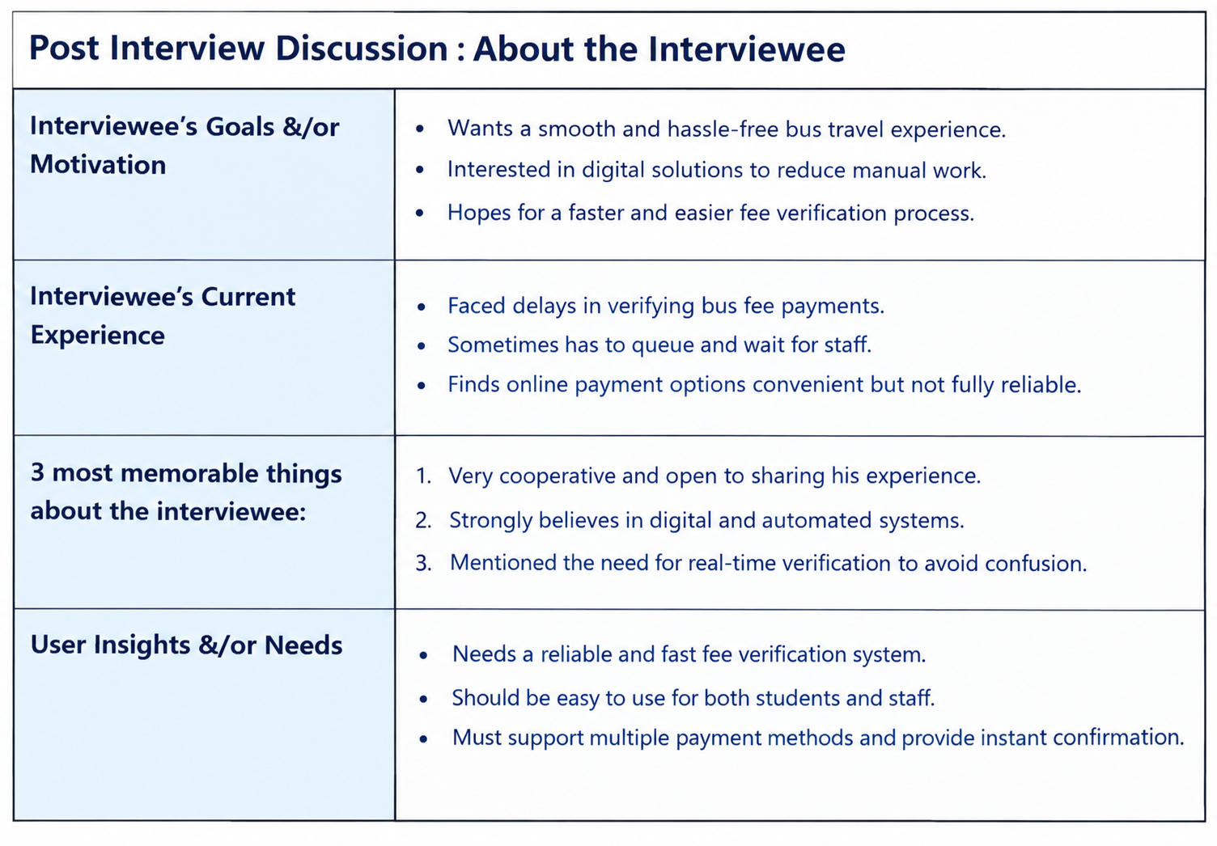
T21 : Post Interview Discussion : About the Interviewee

Slide 8
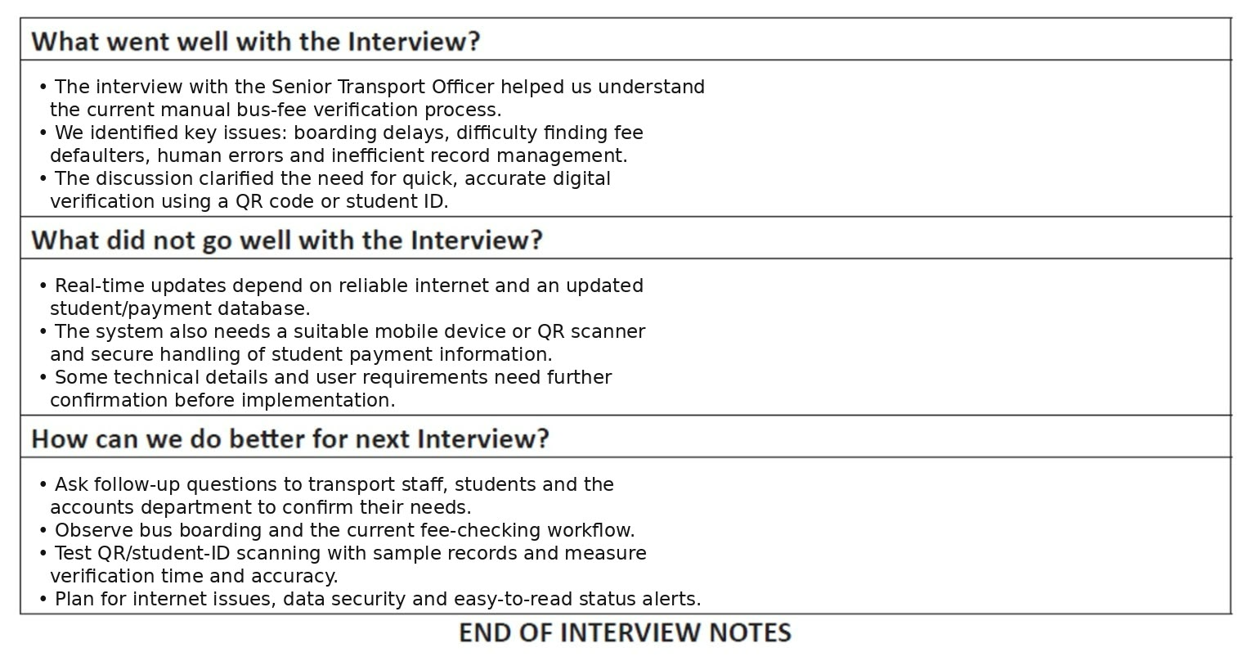
T22 : Post Interview Discussion : About the Process

Slide 9
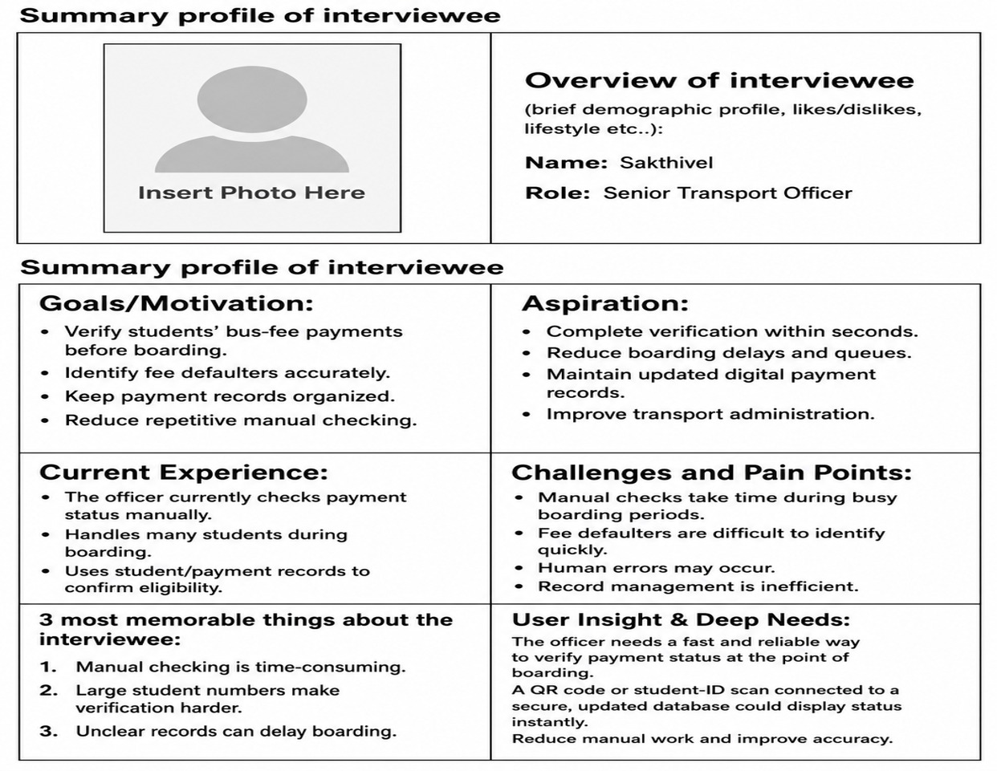
T23 : Post Interview De-brief Presentation

Slide 10
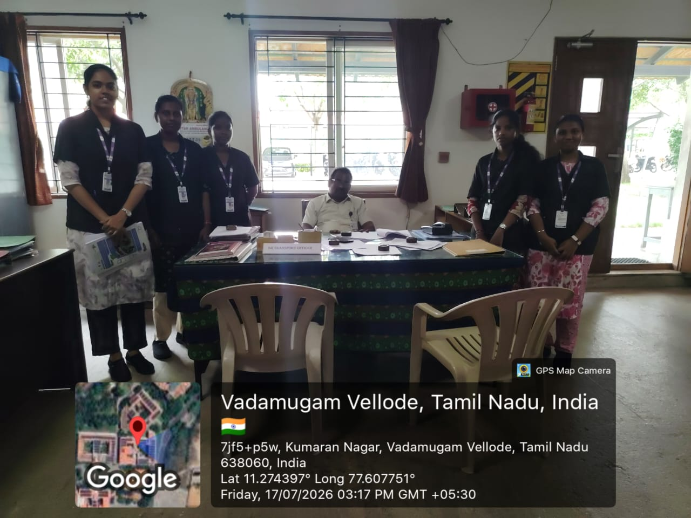
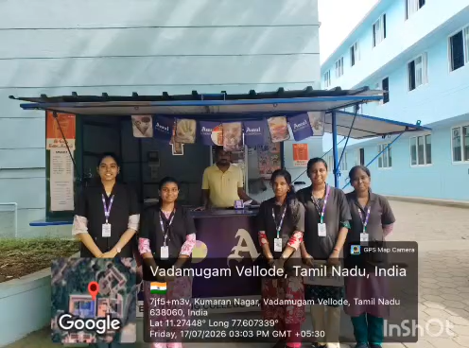
Geo – Tag Photo
Video of the interview

Slide 11
Ex. No. : 4 | Description | Reg. No.
Conduct of Experiment (30) | Empathize: Conduct user research to identify genuine needs. (5)
 | Define: Frame the right problem using insights. (10)
 | Ideate: Create creative solutions. (10)
 | Prototype: Model Creation (5)
Presentation (20) | Presentation & Reflection (10)
 | Depth of Research & Preparation (10)
Viva (10) | Communication & Clarity (5)
 | Response to Questions (5)
Faculty Signature

